Slide 1
Asthma Guidelines
Fahad Al-Ghimlas
MD, MSc, FACP, FCCP, FRCPC
@alghimlas_clinic
Chest Unit – Chest Diseases Hospital
18 April 2019
Updated 2018

Slide 2
@alghimlas_clinic
Background
MR. EASY WHEEZY
34 years old, cigarette Smoker ( 2 packs / day more than 15 years old )
Complaint: cough 2 months ago

Slide 3
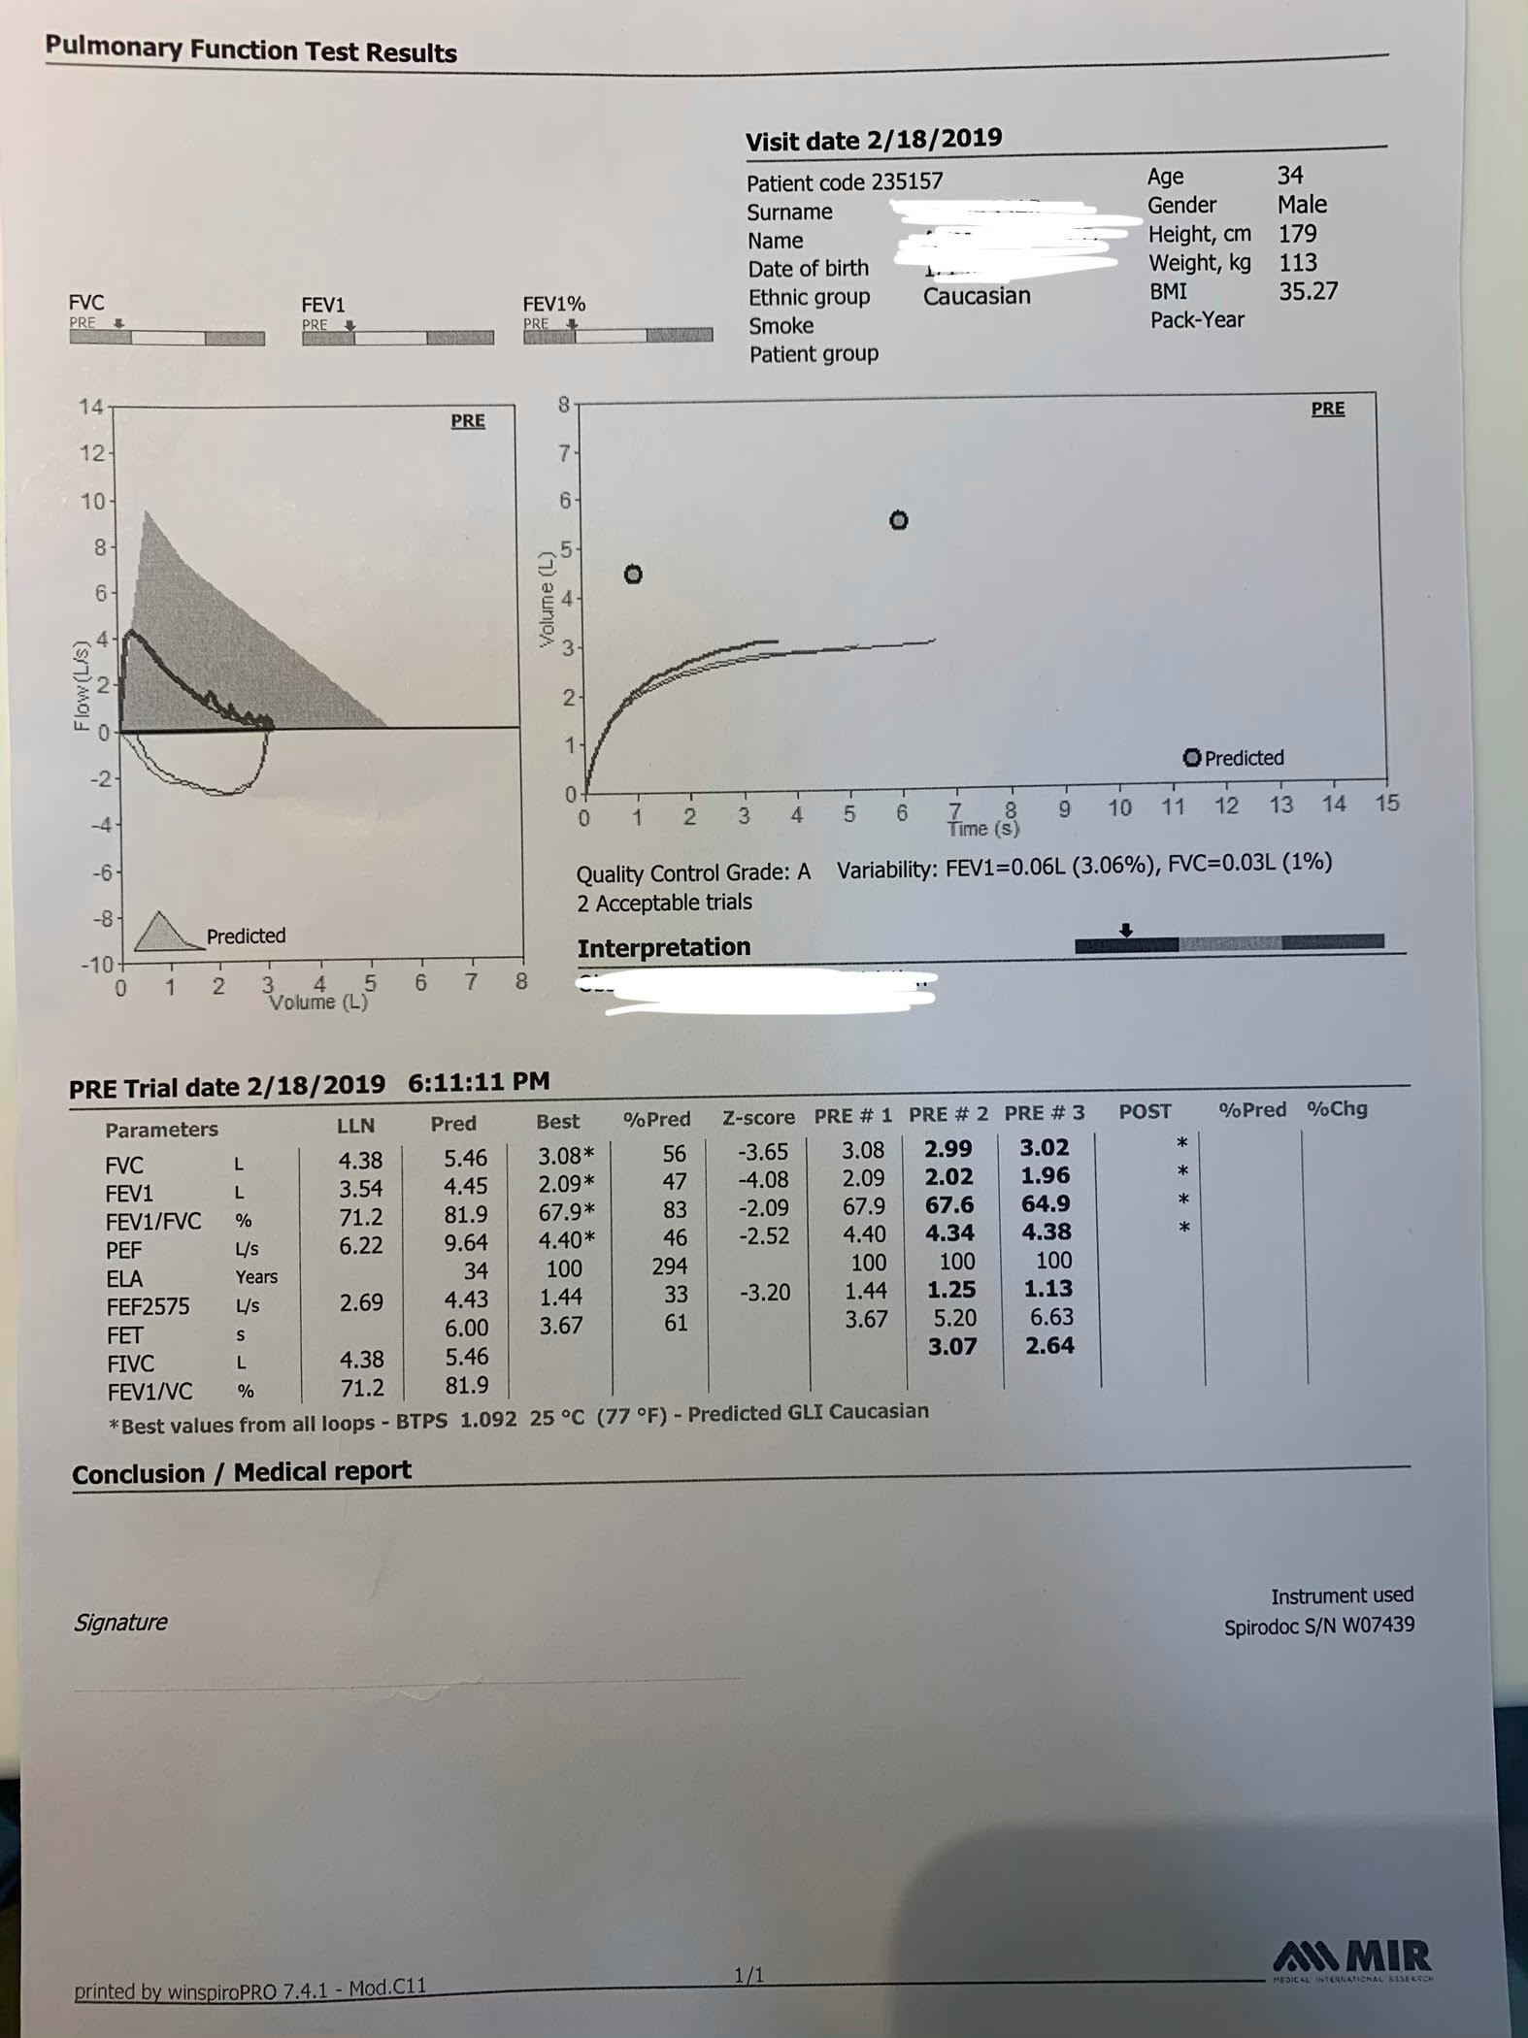
MR. EASY WHEEZY

Slide 4
@alghimlas_clinic
History
MR. EASY WHEEZY
Condition worse 2 weeks ago with progressive exertional dyspnea improved during rest without orthopnea or paroxysmal nocturnal dyspnea, productive cough with scanty whitish sputum, intermittent wheezy chest improved by using B2 agonist inhaler.
He had history of asthma with frequent use of B2 Agonist inhaler, recurrent visits to the ER for nebulization 4 times in the last 4 months.
He sought medical advice and received medical treatment including antibiotics and cough sedatives but without improvement!!.

Slide 5
@alghimlas_clinic
History
MR. EASY WHEEZY
He noticed that the symptoms increasing in the evening , early morning , during the Spring and triggered by cats, exercise and cold weather
Medications: B2 Agonist inhaler PRN

Slide 6
@alghimlas_clinic
Examination
MR. EASY WHEEZY
Vital signs : Temp = 36.8 PR = 85 b/m Bl/p = 130/80 SPO2 = 96% on RA
Auscultation : Harsh vesicular breathing with sibilant rhonchi
Investigations: Chest X ray : Clear

Slide 7
@alghimlas_clinic
What is the most likely cause of this patient’s chronic cough?
A. Pneumonia
B. Interstitial Pulmonary Fibrosis
C. COPD
D. Uncontrolled Asthma
Discussion

Slide 8
@alghimlas_clinic
Discussion
How can you assess a patient with asthma?

Slide 9
@alghimlas_clinic
Discussion
How can you assess a patient with asthma?

Slide 10
@alghimlas_clinic
Discussion
How can you assess a patient with asthma?
D
N
N
D

Slide 11
Global Initiative for Asthma (GINA) What’s new in GINA 2018?

Slide 12
Assessment of risk factors for poor asthma outcomes
Risk factors for exacerbations include:
Uncontrolled asthma symptoms Additional risk factors, even if the patient has few symptoms: High SABA use (≥3 canisters/year) Having ≥1 exacerbation in last 12 months Low FEV₁; higher bronchodilator reversibility Incorrect inhaler technique and/or poor adherence Smoking Obesity, chronic rhinosinusitis, pregnancy, blood eosinophilia Elevated FeNO in adults with allergic asthma taking ICS Ever intubated for asthma
den Dekker 2016
Ulrik Chest 1995, Pongracic JACI 2016
GINA 2018, Box 2-2B (4/4)
Notes:
Additional RFs for exacerbations in GINA 2018
In Box 2-2B, higher bronchodilator reversibility has been added as an additional independent risk factor for exacerbations in both adults and children
Additional RFs for persistent airflow limitation
Pre-term birth, low birth weight and greater infant weight gain have been added to the list of risk factors (

Slide 13
Assessment of risk factors for poor asthma outcomes
Risk factors for exacerbations include:
Uncontrolled asthma symptoms Additional risk factors, even if the patient has few symptoms: High SABA use (≥3 canisters/year) Having ≥1 exacerbation in last 12 months Low FEV₁; higher bronchodilator reversibility Incorrect inhaler technique and/or poor adherence Smoking Obesity, chronic rhinosinusitis, pregnancy, blood eosinophilia Elevated FeNO in adults with allergic asthma taking ICS Ever intubated for asthma
den Dekker 2016
Ulrik Chest 1995, Pongracic JACI 2016
GINA 2018, Box 2-2B (4/4)
Notes:
Additional RFs for exacerbations in GINA 2018
In Box 2-2B, higher bronchodilator reversibility has been added as an additional independent risk factor for exacerbations in both adults and children
Additional RFs for persistent airflow limitation
Pre-term birth, low birth weight and greater infant weight gain have been added to the list of risk factors (

Slide 14
GINA 2018
Diagnosis
Symptoms control and risk factors
(including lung function)
Inhaler technique and adherence
Patient preference
ASSESS
GINA 2018,

Slide 15
GINA 2018
Diagnosis
Symptoms control and risk factors
(including lung function)
Inhaler technique and adherence
Patient preference
ASSESS
ADJUST
Asthma medications
Non-pharmacological strategies
Treat modifiable risk factors
TREATMENT
GINA 2018,

Slide 16
GINA 2018
Diagnosis
Symptoms control and risk factors
(including lung function)
Inhaler technique and adherence
Patient preference
ASSESS
ADJUST
Symptoms
Exacerbations
Side-effects
Patient satisfaction
Lung function
RESPONSE
Asthma medications
Non-pharmacological strategies
Treat modifiable risk factors
TREATMENT
REVIEW
GINA 2018,

Slide 17
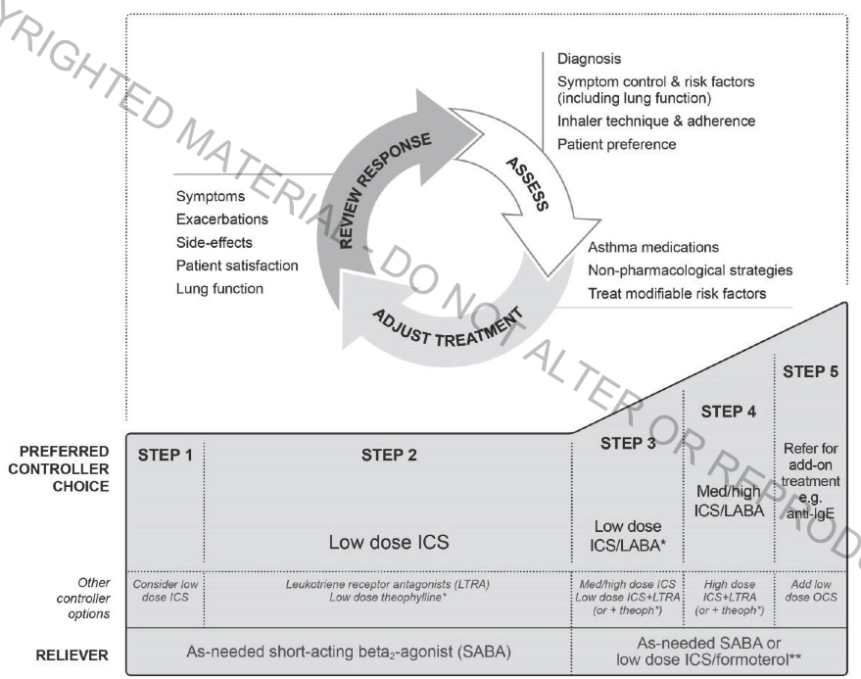

Slide 20
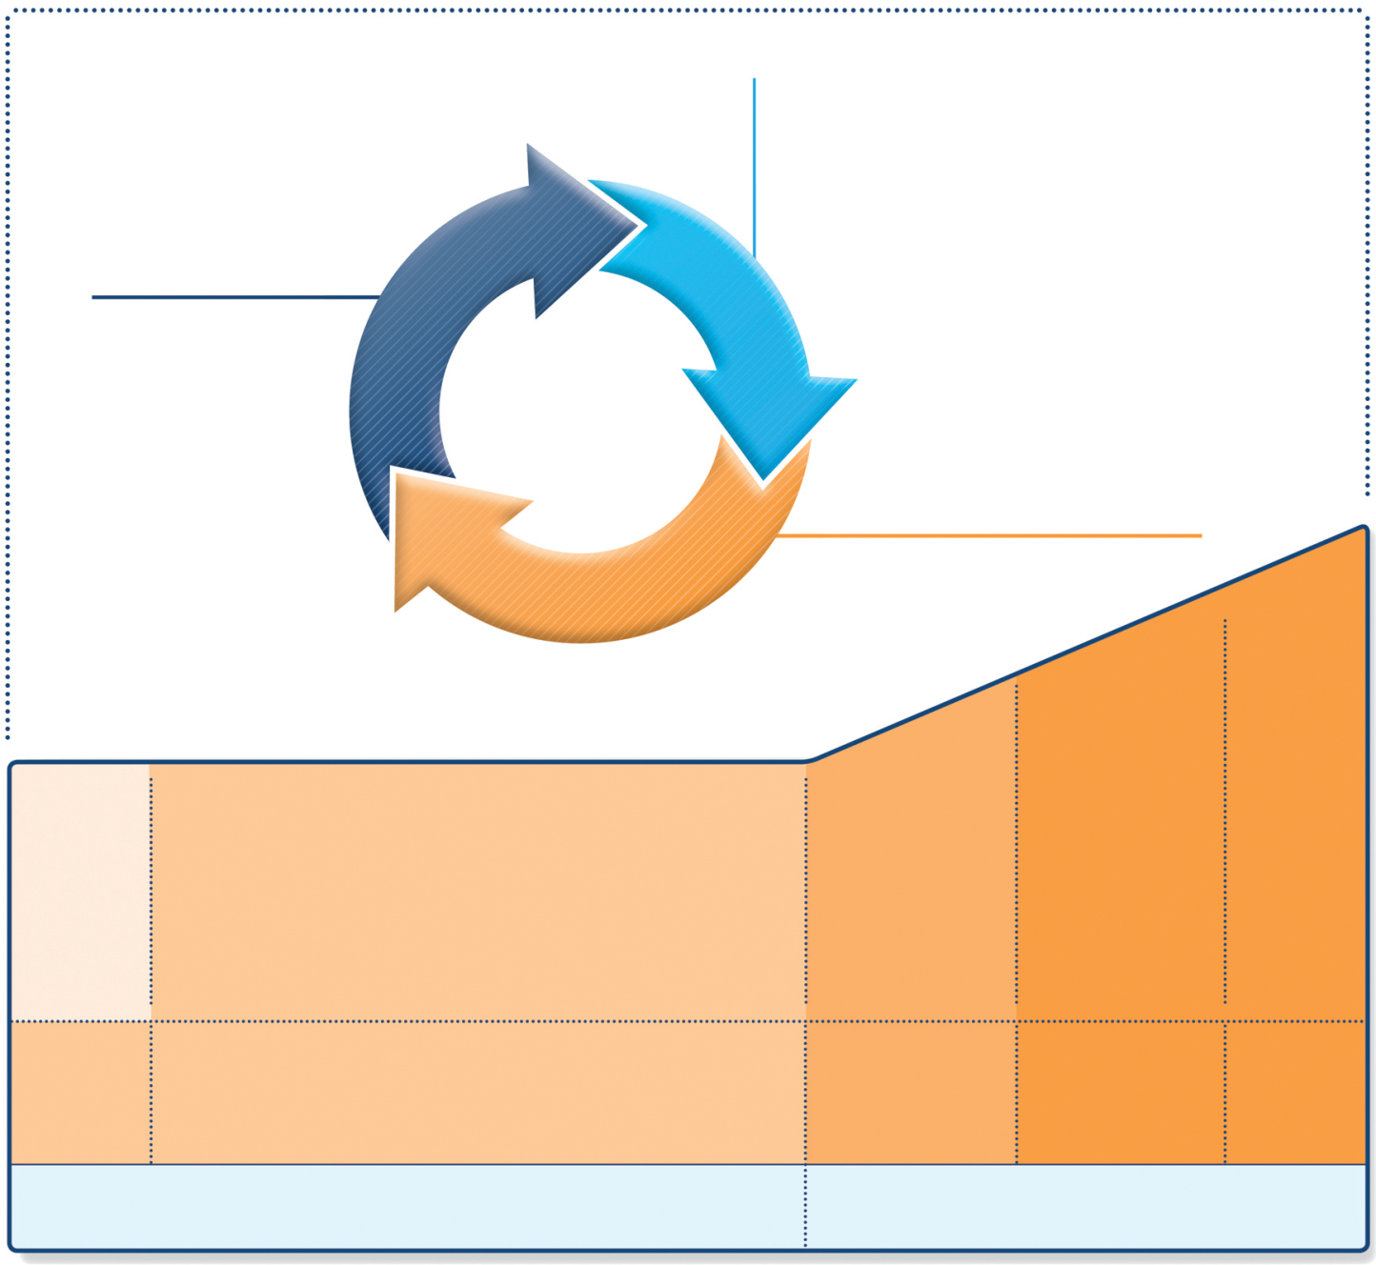
Stepwise management - pharmacotherapy
Diagnosis
Symptom control & risk factors (including lung function)
Inhaler technique & adherence
Patient preference
REVIEW RESPONSE
ASSESS
Symptoms
Exacerbations
Side-effects
Patient satisfaction
Lung function
ADJUST TREATMENT
Asthma medications
Non-pharmacological strategies
Treat modifiable risk factors
STEP 5
STEP 4
STEP 3
Refer for add-on treatment
e.g.
tiotropium,* anti-IgE, anti-IL5*
*Not for children <12 years
**For children 6-11 years, the preferred Step 3 treatment is medium dose ICS
#For patients prescribed BDP/formoterol or BUD/ formoterol maintenance and reliever therapy
 Tiotropium by mist inhaler is an add-on treatment for patients ≥12 years with a history of exacerbations
PREFERRED CONTROLLER CHOICE
STEP 1
STEP 2
Med/high ICS/LABA
Low dose ICS
Low dose ICS/LABA**
Other controller options
Consider low dose ICS
Leukotriene receptor antagonists (LTRA)
Low dose theophylline*
Med/high dose ICS
Low dose ICS + LTRA
(or + theoph*)
Add tiotropium*
Med/high dose ICS + LTRA (or + theoph*)
Add low dose OCS
RELIEVER
As-needed short-acting beta²-agonist (SABA)
As-needed SABA or low dose ICS/formoterol#
GINA 2018, Box 3-5 (2/8) (upper part)

Slide 21
Treatment steps – changes in 2018
Step 1
It is explained that the reason ICS should be considered for patients with mild asthma (rather than prescribing SABA alone) is to reduce their risk of serious exacerbations
Pauwels, Lancet 2003
O’Byrne AJRCCM 2001
Reddel Lancet 2017
GINA 2018, Box 2-2B (4/4)

Slide 22
Stepwise management - pharmacotherapy
Diagnosis
Symptom control & risk factors (including lung function)
Inhaler technique & adherence
Patient preference
REVIEW RESPONSE
ASSESS
Symptoms
Exacerbations
Side-effects
Patient satisfaction
Lung function
ADJUST TREATMENT
Asthma medications
Non-pharmacological strategies
Treat modifiable risk factors
STEP 5
STEP 4
STEP 3
Refer for add-on treatment
e.g.
tiotropium,* anti-IgE, anti-IL5*
*Not for children <12 years
**For children 6-11 years, the preferred Step 3 treatment is medium dose ICS
#For patients prescribed BDP/formoterol or BUD/ formoterol maintenance and reliever therapy
 Tiotropium by mist inhaler is an add-on treatment for patients ≥12 years with a history of exacerbations
PREFERRED CONTROLLER CHOICE
STEP 1
STEP 2
Med/high ICS/LABA
Low dose ICS
Low dose ICS/LABA**
Other controller options
Consider low dose ICS
Leukotriene receptor antagonists (LTRA)
Low dose theophylline*
Med/high dose ICS
Low dose ICS + LTRA
(or + theoph*)
Add tiotropium*
Med/high dose ICS + LTRA (or + theoph*)
Add low dose OCS
RELIEVER
As-needed short-acting beta²-agonist (SABA)
As-needed SABA or low dose ICS/formoterol#
GINA 2018, Box 3-5 (2/8) (upper part)

Slide 23
Treatment steps – changes in 2018
Steps 3-4
From the large FDA LABA safety studies: adding LABA to ICS in a combination inhaler reduces risk of exacerbations and improves symptoms and lung function, compared with the same dose of ICS alone
Stempel NEJM 2016
Peters NEJM 2016
GINA 2018, Box 2-2B (4/4)

Slide 24
Follow-up after an asthma exacerbation
Follow up all patients regularly after an exacerbation, until symptoms and lung function return to normal
Patients are at increased risk during recovery from an exacerbation
The opportunity
Exacerbations often represent failures in chronic asthma care, and they provide opportunities to review the patient’s asthma management
GINA 2018, Box 2-2B (4/4)

Slide 25
Follow-up after an asthma exacerbation
At follow-up visit(s), check:
Patient’s understanding of cause of flare-up
Modifiable risk factors, e.g. smoking
Adherence with medications
SABA is being taken only as-needed, not regularly
Inhaler technique skills
Written asthma action plan
GINA 2018, Box 2-2B (4/4)

Slide 26
@alghimlas_clinic
What is the value that is measured by spirometry?
a. Residual volume
b. Total lung capacity
c. Functional residual capacity
d. Forced expiratory volume

Slide 27
@alghimlas_clinic
Discussion
What's the role of spirometry in asthma?
Lung function should be assessed at diagnosis or start of treatment; after 3–6 months of controller treatment to assess the patient’s personal best FEV1; and periodically thereafter.

Slide 28
@alghimlas_clinic
Examination
Spirometry:
Test | Pre-Bronchodilator (BD) |  |  | Post- BD
 | Actual | Predicted | % Predicted | Actual
FVC (L) | 3.00 | 3.09 | 97 | 3.20
FEV₁ (L) | 1.65 | 2.57 | 66 | 2.50
FEV₁/FVC (%) | 54 | 83 |  | 78

Slide 29
MR. EASY WHEEZY

Slide 30
@alghimlas_clinic
Discussion
Definition of Asthma
Asthma is a heterogeneous disease, usually characterized by chronic airway inflammation. It is defined by the history of respiratory symptoms such as wheeze, shortness of breath, chest tightness and cough that vary over time and in intensity, together with variable expiratory airflow limitation
GINA, 2018

Slide 31
@alghimlas_clinic
Discussion
Definition of Asthma
Asthma in smokers /ex-smokers
Asthma and COPD may be difficult to distinguish in clinical practice, particularly in older patients and smokers and ex-smokers, and these conditions may overlap (asthma-COPD overlap syndrome, or ACOS).
GINA, 2018

Slide 32
@alghimlas_clinic
Discussion
Definition of Asthma
Asthma in smokers /ex-smokers
Clinically important bronchodilator reversibility (>12% and >200 mL) is often found in COPD.
The history and pattern of symptoms and past records can help to distinguish these patients from those with long-standing asthma who have developed fixed airflow limitation.
Uncertainty in the diagnosis should prompt early referral for specialized investigation and treatment recommendations.
GINA, 2018

Slide 33
@alghimlas_clinic
Discussion
Interpreting interval lung function in asthma
A low FEV1 percent predicted:
Identifies patients at risk of asthma exacerbations, independent of symptom levels.
Is a risk factor for lung function decline, independent of symptom levels.
Suggests limitation of lifestyle, or poor perception of airflow limitation, which may be due to untreated airway inflammation.

Slide 34
@alghimlas_clinic
Discussion
Interpreting interval lung function in asthma
A normal’ or high FEV1 in a patient with frequent respiratory symptoms (especially when symptomatic): Prompts consideration of alternative causes for the symptoms; e.g. cardiac disease, or cough due to post-nasal drip or gastro esophageal reflux disease .

Slide 35
@alghimlas_clinic
Discussion
Interpreting interval lung function in asthma
Persistent bronchodilator reversibility: Finding significant bronchodilator reversibility (increase in FEV1 >12% and >200 mL from baseline) in a patient taking controller treatment, or who has taken a short-acting beta2-agonist within 4 hours, or a LABA within 12 hours, suggests uncontrolled asthma.

Slide 36
@alghimlas_clinic
Discussion
Interpreting changes of lung function in clinical practice:
Some patients may have a faster than average decrease in lung function, and develop ‘fixed’ (incompletely reversible) airflow limitation. While a trial of higher-dose ICS/LABA and/or systemic corticosteroids may be appropriate to see if FEV1 can be improved, high doses should not be continued if there is no response.

Slide 37
@alghimlas_clinic
Discussion
Interpreting changes of lung function in clinical practice:
The minimal important difference for improvement and worsening in FEV1 based on patient perception of change has been reported to be about 10%.
(GINA., 2018)

Slide 38
Asthma-COPD overlap
“Asthma-COPD overlap” does not mean a single disease entity
It includes patients with several different forms of airways disease (phenotypes) caused by a range of different underlying mechanisms
Treatment of patients with asthma-COPD overlap
Few studies – overlap patients are excluded from most RCTs
The interim safety recommendation for ICS to be included in treatment for patients with COPD and a history of asthma is supported by a well-designed case-control study (Gershon JAMA 2014)
GINA 2018, Box 2-2B (4/4)

Slide 39
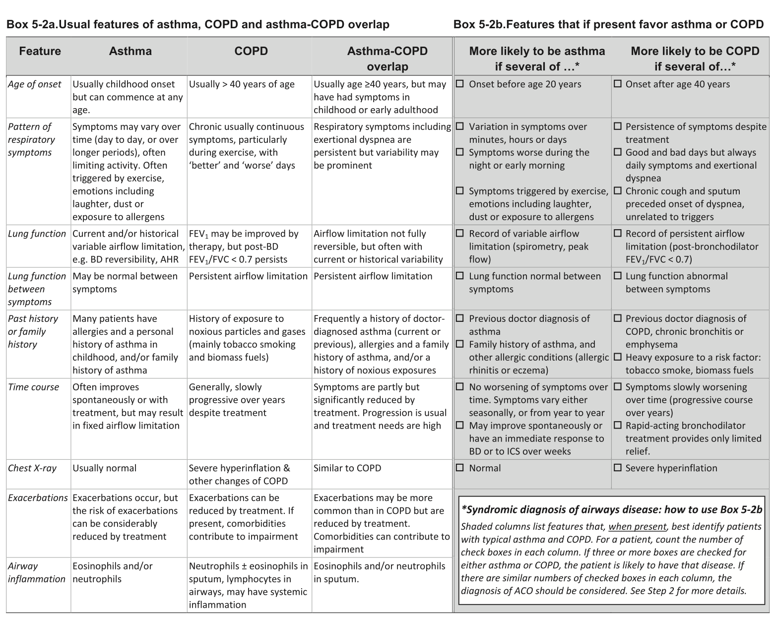

Slide 40
@alghimlas_clinic
Discussion
STEPWISE APPROACH TO DIAGNOSIS OF PATIENTS WITH RESPIRATORY SYMPTOMS
Commence initial therapy:
If the syndromic assessment favors asthma as a single diagnosis Commence treatment as described in the GINA strategy report. Pharmacotherapy is based on ICS, with add-on treatment if needed, e.g. add-on long-acting beta2-agonist (LABA) and/or long-acting muscarinic antagonist (LAMA).

Slide 41
@alghimlas_clinic
Discussion
STEPWISE APPROACH TO DIAGNOSIS OF PATIENTS WITH RESPIRATORY SYMPTOMS
Commence initial therapy:
If the syndromic assessment favors COPD as a single disease Commence treatment as in the current GOLD strategy report. Pharmacotherapy starts with symptomatic treatment with bronchodilators (LABA and/or LAMA) or combination therapy, but not ICS alone (as monotherapy) – CAUTION with LABA monotherapy. .

Slide 42
@alghimlas_clinic
Discussion
STEPWISE APPROACH TO DIAGNOSIS OF PATIENTS WITH RESPIRATORY SYMPTOMS
Commence initial therapy:
If the syndromic assessment suggests ACO, the recommended default position is to start treatment for asthma until further investigations have been performed.
Usually also add a LABA and/or LAMA, or continue these together with ICS if already prescribed.

Slide 43
@alghimlas_clinic
Which of the following is TRUE concerning
the use of inhaled corticosteroids (ICSs) for asthma?
a. They are all pregnancy category D or X
b. ICSs cause hypothalamic-pituitary-adrenal axis (HPA) suppression to a greater degree than oral systemic corticosteroids
c. ICSs are considered the preferred long-term therapy to control asthma
d. ICSs should be used for the relief of acute bronchospasm

Slide 44
Stepwise management - pharmacotherapy
Diagnosis
Symptom control & risk factors (including lung function)
Inhaler technique & adherence
Patient preference
REVIEW RESPONSE
ASSESS
Symptoms
Exacerbations
Side-effects
Patient satisfaction
Lung function
ADJUST TREATMENT
Asthma medications
Non-pharmacological strategies
Treat modifiable risk factors
STEP 5
STEP 4
STEP 3
Refer for add-on treatment
e.g.
tiotropium,* anti-IgE, anti-IL5*
*Not for children <12 years
**For children 6-11 years, the preferred Step 3 treatment is medium dose ICS
#For patients prescribed BDP/formoterol or BUD/ formoterol maintenance and reliever therapy
 Tiotropium by mist inhaler is an add-on treatment for patients ≥12 years with a history of exacerbations
PREFERRED CONTROLLER CHOICE
STEP 1
STEP 2
Med/high ICS/LABA
Low dose ICS
Low dose ICS/LABA**
Other controller options
Consider low dose ICS
Leukotriene receptor antagonists (LTRA)
Low dose theophylline*
Med/high dose ICS
Low dose ICS + LTRA
(or + theoph*)
Add tiotropium*
Med/high dose ICS + LTRA (or + theoph*)
Add low dose OCS
RELIEVER
As-needed short-acting beta²-agonist (SABA)
As-needed SABA or low dose ICS/formoterol#
GINA 2018, Box 3-5 (2/8) (upper part)

Slide 45
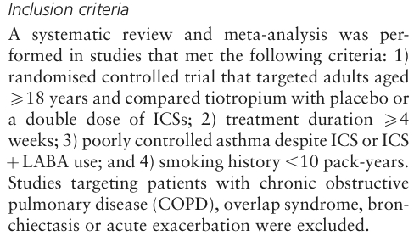

Slide 46
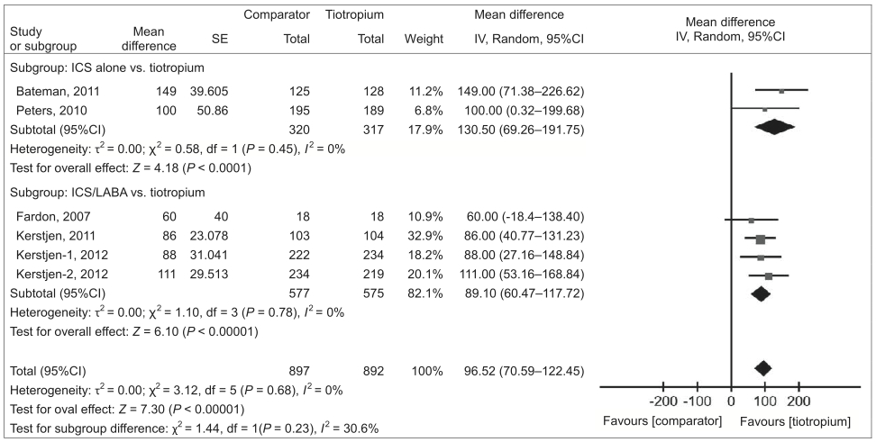
FEV1

Slide 47
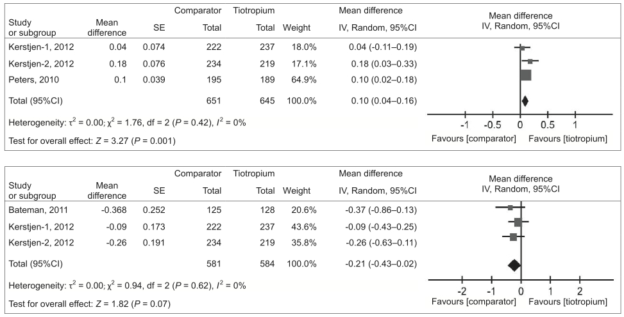
AQLQ

Slide 48
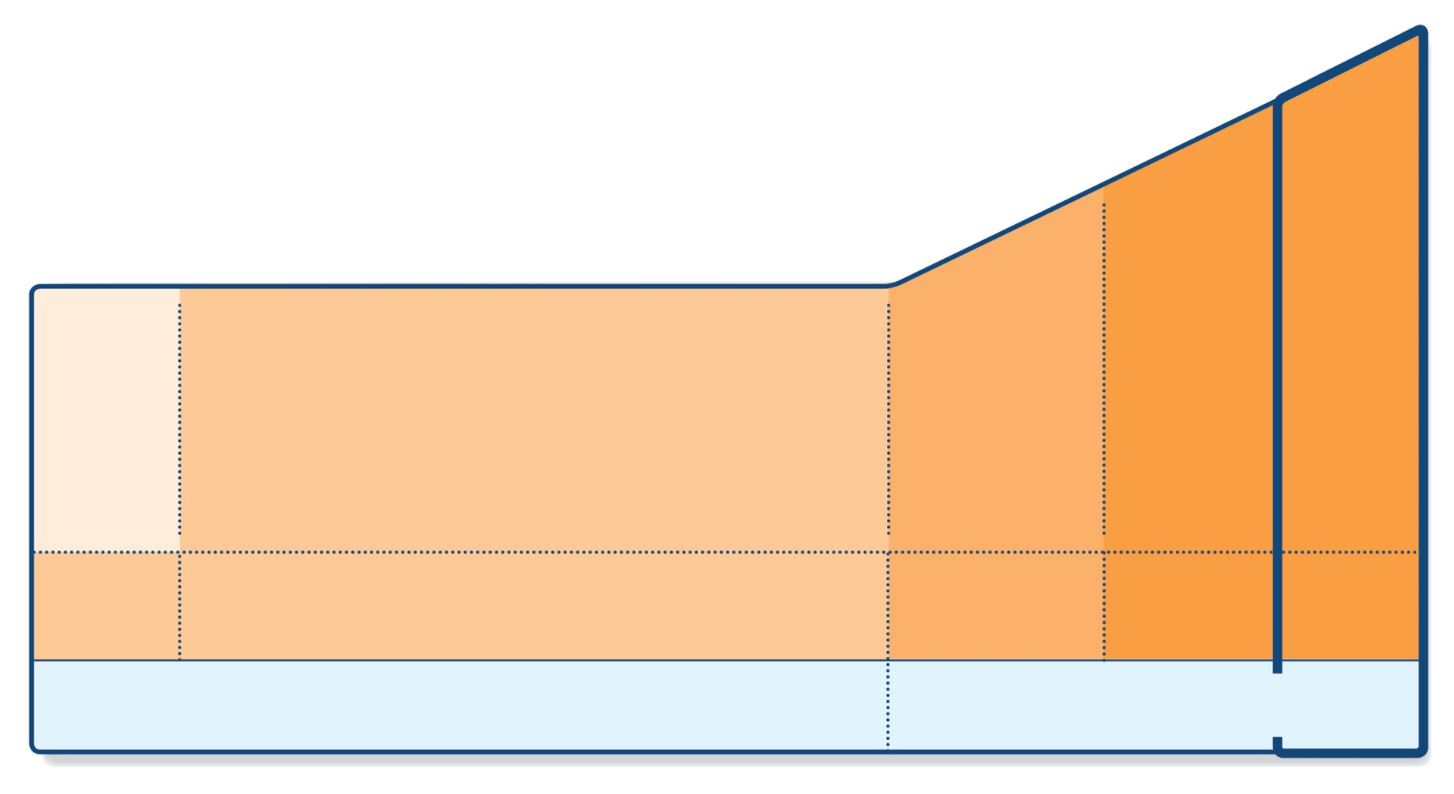
Step 5 – higher level care and/or add-on treatment
UPDATED!
STEP 5
STEP 4
PREFERRED CONTROLLER CHOICE
STEP 1
STEP 2
STEP 3
Refer for add-on treatment
e.g.
tiotropium,* omalizumab, mepolizumab*
Med/high ICS/LABA
Low dose ICS/LABA**
Low dose ICS
Other controller options
Consider low dose ICS
Leukotriene receptor antagonists (LTRA)
Low dose theophylline*
Med/high dose ICS
Low dose ICS+LTRA
(or + theoph*)
Add tiotropium*
High dose ICS + LTRA (or + theoph*)
Add low dose OCS
As-needed short-acting beta₂-agonist (SABA)
As-needed SABA or low dose ICS/formoterol#
RELIEVER
*Not for children <12 years
**For children 6-11 years, the preferred Step 3 treatment is medium dose ICS
#For patients prescribed BDP/formoterol or BUD/ formoterol maintenance and reliever therapy
 Tiotropium by mist inhaler is an add-on treatment for patients ≥12 years with a history of exacerbations
GINA 2016, Box 3-5, Step 5 (8/8)

Slide 49
Step 5 – higher level care and/or add-on treatment
UPDATED!
Preferred option is referral for specialist investigation and consideration of add-on treatment
If symptoms uncontrolled or exacerbations persist despite Step 4 treatment, check inhaler technique and adherence before referring
Add-on tiotropium for ≥12 years with history of exacerbations
Add-on omalizumab (anti-IgE) for severe allergic asthma
Add-on mepolizumab (anti-IL5) for severe eosinophilic asthma (≥12 yrs)
GINA 2016

Slide 50
@alghimlas_clinic
STEP 5 GINA
STEPWISE APPROACH TO DIAGNOSIS OF PATIENTS WITH RESPIRATORY SYMPTOMS
Referral for specialized investigations (if necessary)
(GINA., 2018)

Slide 52
THANKS! QUESTIONS?
Asthma Guidelines
Fahad Al-Ghimlas
MD, MSc, FACP, FCCP, FRCPC
@alghimlas_clinic
Chest Unit – Chest Diseases Hospital
18 April 2019
Updated 2018

